Slide 1
DSL Productization
Anuparna Ganguly
04/08/2025

Slide 2
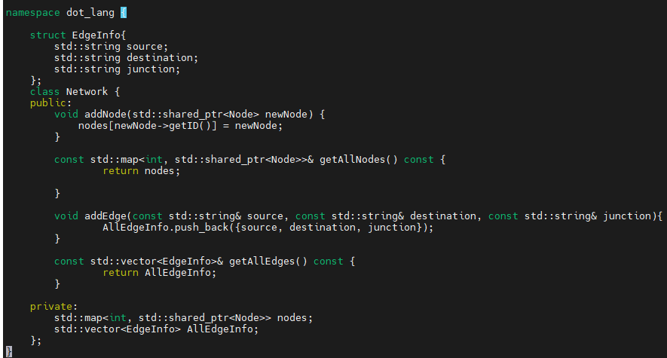

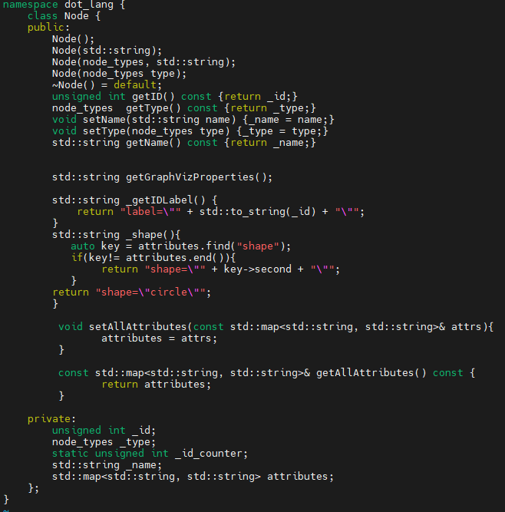
Decoupling Analytical Model from DSL(Parsing)
start
Network.h
Lexer
Token
Parser
ParseTree
Visit Node
Visit Edge
dot_lang
Read .dot file
Node and Attributes
Set data structure
Source, destination, junction
No
i<999 ?
Node.h
Node and Attributes
stop
i=i+1
Get each node
Get corresponding Node’s attributes
Create primitives
Put it in data structure
Get source, destination, junction_name
Put it in data structure
Set rate & ca
Source, destination, junction
Invoke analytical model
End

Slide 3
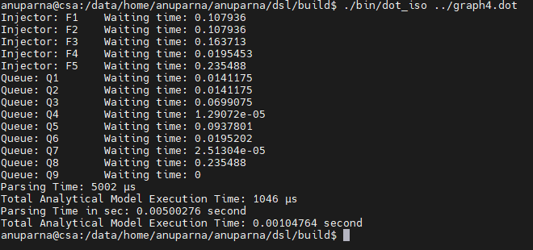
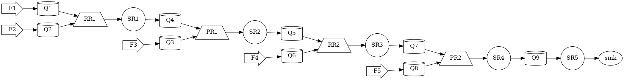
Updates
Node
Primitive
Injector
Queue
Arbiter
RoundRobin
Priority
Server
Sink
Primitive is no longer inherited from Node.
All Primitives belongs to Analytical_Model namespace instead of dot_lang .
A new method setDataStructure() is introduced to organize internal data structure.
Output of the model is now matched and validated against previous results for correctness.
dot_lang
Analytical_Model

Slide 4
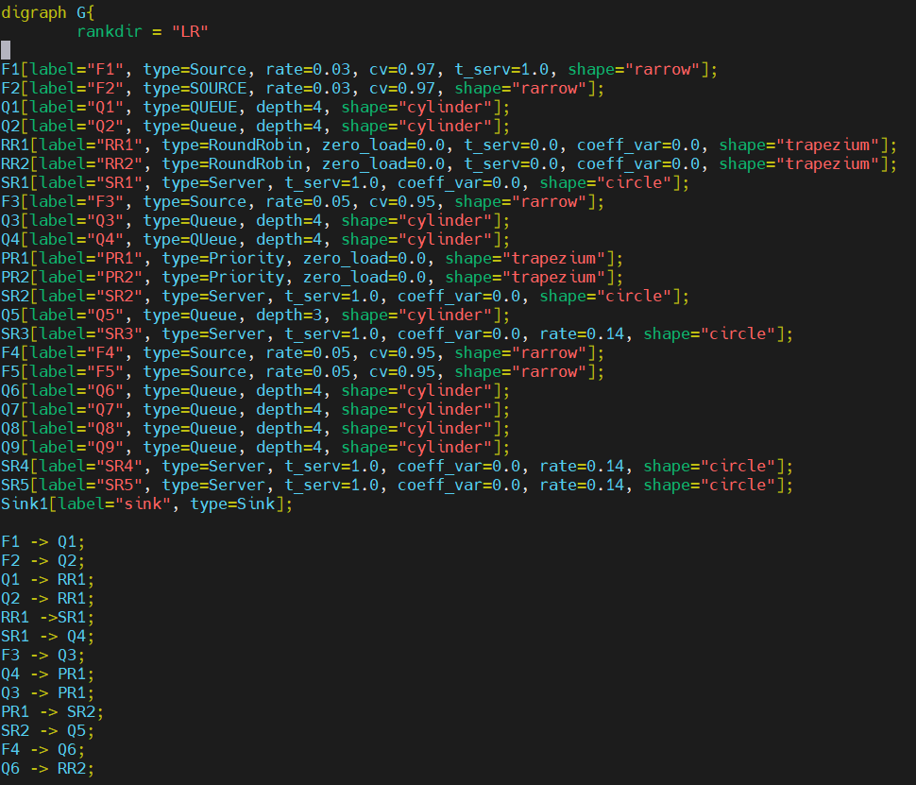
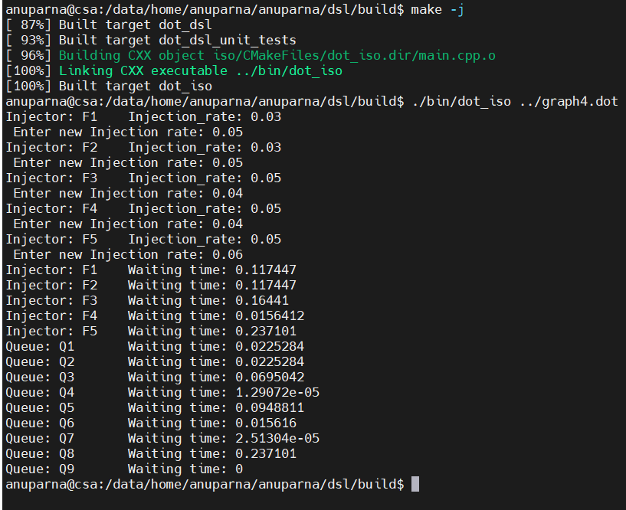
Runtime initialization of injection_rate and coeff_var
Output before updation
Output after updation
Input file

Slide 5
Future Work
Make traffic-specific parameters optional in the DSL and initialize them only if present.
Default values for optional node attributes.
Improve unit test coverage to at least 90%, covering new logic and edge cases.

